Slide 1
Keeping the Vineyard
Lesson 21
Song of Solomon 2:15
Song of Solomon Study
By Rev. James R. Reynolds, Sr.

Slide 2
Song of Solomon Lessons
#16: The Bride's Charge
#17: The Approach of the Bridegroom
#18: Revelations of the Bridegroom
#19: A Message from the Bridegroom
#20: Panorama of the Bride
#21: Keeping the Vineyard

Slide 3
Song of Solomon 2:1-4
1 I am the rose of Sharon, and the lily of the valleys.
2 As the lily among thorns, so is my love among the daughters.
3 As the apple tree among the trees of the wood, so is my beloved among the sons. I sat down under his shadow with great delight, and his fruit was sweet to my taste.
4 He brought me to the banqueting house, and his banner over me was love.

Slide 4
Song of Solomon 2:5-8
5 Stay me with flagons, comfort me with apples: for I am sick of love.
6 His left hand is under my head, and his right hand doth embrace me.
7 I charge you, O ye daughters of Jerusalem, by the roes, and by the hinds of the field, that ye stir not up, nor awake my love, till he please.
8 The voice of my beloved! behold, he cometh leaping upon the mountains, skipping upon the hills.

Slide 5
Song of Solomon 2:9-11
9 My beloved is like a roe or a young hart: behold, he standeth behind our wall, he looketh forth at the windows, shewing himself through the
10 My beloved spake, and said unto me, Rise up, my love, my fair one, and come away.
11 For, lo, the winter is past, the rain is over and gone;

Slide 6
Song of Solomon 2:12-13
12 The flowers appear on the earth; the time of the singing of birds is come, and the voice of the turtle is heard in our land;
13 The fig tree putteth forth her green figs, and the vines with the tender grape give a good smell. Arise, my love, my fair one, and come away.

Slide 7
Matthew 24:32
Now learn a parable of the fig tree; When his branch is yet tender, and putteth forth leaves, ye know that summer is nigh:

Slide 8
Song of Solomon 2:14,15
14 O my dove, that art in the clefts of the rock, in the secret places of the stairs, let me see thy countenance, let me hear thy voice; for sweet is thy voice, and thy countenance is comely.
15 Take us the foxes, the little foxes, that spoil the vines: for our vines have tender grapes.

Slide 9
Keeping the Vineyard
Text: Song of Solomon 2:15
I. Subtlety of Her Enemy
II. Damage by Her Enemy
III. Most Critical Time

Slide 10
INTRODUCTION
The Bridegroom is giving a warning of the danger the Bride faces in her growth, preparation, and progress in the Spirit.
Great Privilege requires Great Responsibility.

Slide 11
INTRODUCTION
1:6 …they made me the keeper of the vineyards; but mine own vineyard have I not kept.
Bridegroom’s admonition “You keep your own vineyard.”
The Bride has enemies.

Slide 12
I. Subtlety of Her Enemy “Take us the foxes…”
A. The Action to the Enemy
The Bridegroom warns the Bride to take charge of her vineyard. He is going to give her the strength, but she is the one that must do it.

Slide 13
I. Subtlety of Her Enemy A. The Action to the Enemy
1. The Word “Take” (hebrew ‘achaz)
To seize; to take hold
There is going to be some effort.
Christians are too relaxed concerning their obligation to truth.
If the devil can just get you on easy street, he has you already.

Slide 14
We are in a Battle!
2Ti 2:3 Thou therefore endure hardness, as a good soldier of Jesus Christ.
Eph 6:12 For we wrestle…against the rulers of the darkness of this world, against spiritual wickedness in high places.
Phil. 3:14 I press toward the mark for the prize of the high calling of God in Christ Jesus.

Slide 15
I John 14:15
If ye love me, keep my commandments.

Slide 16
I John 5:3
For this is the love of God, that we KEEP his commandments: and his commandments are not grievous.
(But we do have an enemy who plays with our flesh.)

Slide 17
Ephesians 6:12
For we wrestle not against flesh and blood, but against principalities, against powers, against the rulers of the darkness of this world, against spiritual wickedness in high places.

Slide 18
Judges 15:4
And Samson went and caught three hundred foxes, and took firebrands, and turned tail to tail, and put a firebrand in the midst between two tails.

Slide 19
Catch Foxes Like Samson
You easily see your neighbor’s foxes, but not your own.
It might surprise you How many you catch.
You want a great victory? Catch the foxes in your vineyard.

Slide 20
I. The Subtlety of the Enemy “Take us the foxes…”
A. The Word Take
B. The Nature of the Enemy

Slide 21
Jeremiah 17:9
The heart is deceitful above all things, and desperately wicked: who can know it?

Slide 22
I. The Subtlety of the Enemy “Take us the foxes…”
A. The Word Take
B. The Nature of the Enemy
The fox is deceptive, cunning, treacherous, sly, he plays tricks.
The longer they stay, the harder it is to get rid of them.

Slide 23
Matthew 13:18-20
18 Hear ye therefore the parable of the sower.
19 When any one heareth the word of the kingdom, and understandeth it not, then cometh the wicked one, and catcheth away that which was sown in his heart. This is he which received seed by the way side.
20 But he that received the seed into stony places, the same is he that heareth the word, and anon with joy receiveth it;

Slide 24
Matthew 13:21
Yet hath he not root in himself, but dureth for a while: for when tribulation or persecution ariseth because of the word, by and by he is offended.

Slide 25
Matthew 13:22
He also that received seed among the thorns is he that heareth the word; and the care of this world, and the deceitfulness of riches, choke the word, and he becometh unfruitful.

Slide 26
What happened?
The Vineyard was flourishing, had tender grapes, and a promise of a harvest.
The seed must have begun to produce something or there was nothing to choke.

Slide 27
Mark 4:14-15
Mr 4:14 The sower soweth the word.
15 And these are they by the way side, where the word is sown; but when they have heard, Satan cometh immediately, and taketh away the word that was sown in their hearts.

Slide 28
Mark 4:16-17
16 And these are they likewise which are sown on stony ground; who, when they have heard the word, immediately receive it with gladness;
17 And have no root in themselves, and so endure but for a time: afterward, when affliction or persecution ariseth for the word's sake, immediately they are offended.

Slide 29
Mark 4:18-19
18 And these are they which are sown among thorns; such as hear the word,
19 And the cares of this world, and the deceitfulness of riches, and the lusts of other things entering in, choke the word, and it becometh unfruitful.

Slide 30
Luke 8:11-12
11 Now the parable is this: The seed is the word of God.
12 Those by the way side are they that hear; then cometh the devil, and taketh away the word out of their hearts, lest they should believe and be saved.

Slide 31
Luke 8:13
13 They on the rock are they, which, when they hear, receive the word with joy; and these have no root, which for a while believe, and in time of temptation fall away.

Slide 32
Luke 8:14
14 And that which fell among thorns are they, which, when they have heard, go forth, and are choked with cares and riches and pleasures of this life, and bring no fruit to perfection.

Slide 33
I. Subtlety of the Enemy B. The Nature of the Enemy
What are the foxes?
1. Bad Habits
Develop good habits & take hold of and crush bad habits.

Slide 34
I. Subtlety of the Enemy B. The Nature of the Enemy
What are the foxes?
1. Bad Habits
2. Slang Words
The little Bride will avoid slangs and euphemisms.

Slide 35
Euphemism & Slang
Basically, a euphemism is using a word that doesn't sound as bad as the one that most consider offensive, but the meaning of the word is the same. So there is no change in meaning when we use an euphemism.

Slide 36
Fox have your Tongue?
gee = Jesus
gosh = God
golly = God, Holy Ghost
darn, dang= Damn
heck = Hell

Slide 37
Psalm 19:14
Let the words of my mouth, and the meditation of my heart, be acceptable in thy sight, O LORD, my strength, and my redeemer.

Slide 38
Clean Up
Clean up your thinking and speech so God can move.

Slide 39
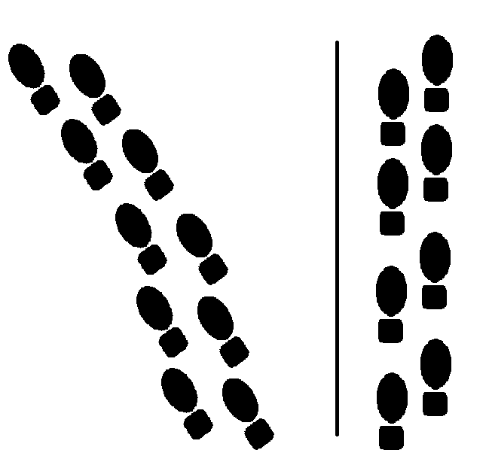
Is Your Tongue Godly?
Slang
Clean

Slide 40
I. Subtlety of the Enemy B. The Nature of the Enemy
What are the foxes?
1. Bad Habits
2. Slang Words
3. Weaknesses
Weaknesses in our nature and character.

Slide 41
What is meant by weakness?
EXAMPLE:
“I want to serve God BUT…”
BUT a little fox finds it way in there instead.

Slide 42
I. Subtlety of the Enemy B. The Nature of the Enemy
What are the foxes?
1. Bad Habits
2. Slang Words
3. Weaknesses
4. Wasting Time

Slide 43
Ephesians 5:16
Redeeming the time, because the days are evil.

Slide 44
I. Subtlety of the Enemy B. The Nature of the Enemy
What are the foxes?
1. Bad Habits
2. Slang Words
3. Weaknesses
4. Wasting Time

Slide 45
I. Subtlety of the Enemy B. The Nature of the Enemy
What are the foxes?
5. Foolish Talking
6. Neglect of Prayer
7. Neglect of God’s Word
8. Error in Doctrine
9. Lack of Conviction

Slide 46
What do I Believe?
Ephesians 4:14
That we henceforth be no more children, tossed to and fro, and carried about with every wind of doctrine, by the sleight of men, and cunning craftiness, whereby they lie in wait to deceive;

Slide 47
Firmness or Compromise
Lack of firmness and conviction has lead the Church into compromise.
Jesus never ran or backed down from anyone.
Christ was firm in his convictions.
We must not compromise!

Slide 48
I. The Subtlety of the Enemy “Take us the [little] foxes…”
A. The Word Take
B. The Nature of the Enemy
C. The Size of the Greatest Enemies
→LITTLE foxes are too often overlooked.

Slide 49
LITTLE Foxes
The adjective little has a most significant meaning. It is a WARNING and a REVELATION of why there is fruitlessness in our lives.

Slide 50
I. The Subtlety of the Enemy C. Size of the Greatest Enemies
“Little” Because :
They are young.
They are least important.
They are least noticed.

Slide 51
Foxes…where?
The little foxes hide under vines at pruning time.
Foxes are born often under the vines.
If the vineyard is neglected the foxes can hide.

Slide 52
Keeping the Vineyard
Text: Song of Solomon 2:15
I. Subtlety of Her Enemy
II. Damage by Her Enemy

Slide 53
II. Damage by Her Enemy “…that spoil the vines…”
SPOIL means to strangle.
1. The Believer is a branch

Slide 54
John 15:5
I am the vine, ye are the branches: He that abideth in me, and I in him, the same bringeth forth much fruit: for without me ye can do nothing.

Slide 55
II. Damage by Her Enemy “…that spoil the vines…”
The Believer is a branch, a vine.
The sap is the life of Christ.
Foxes prevent the pure river of the Life of Christ to flow.
The grapes are the fruit.
The results of Christ living and dwelling in our lives.

Slide 56
II. Damage by Her Enemy C. The grapes are the fruit.
There is a difference between the GIFTS and FRUIT.
Some folks receive the gifts, and have very little fruit.

Slide 57
John 15:2
Every branch in me that beareth not fruit he taketh away: and every branch that beareth fruit, he purgeth it, that it may bring forth more fruit.

Slide 58
John 15:8
Herein is my Father glorified, that ye bear much fruit; so shall ye be my disciples.

Slide 59
WATCH OUT!
The little foxes will strangle your experience and prevent fruit.

Slide 60
Keeping the Vineyard
Text: Song of Solomon 2:15
I. Subtlety of Her Enemy
II. Damage by Her Enemy
III. Most Critical Time

Slide 61
III. Most Critical Time “…our vines have tender grapes…”
Little foxes hide in winter under the vines.
In the spring they come out.
Sunshine – Rain – Warmth

Slide 62
III. Most Critical Time When is the most critical time?
When God begins to work.
Collectively and personally.
Be on guard, watch out.
Saints stop a move God and not sinners.

Slide 63
III. Most Critical Time When is the most critical time?
When the Word is being revealed.
Satan attacks the man of God.
It is going to cost you to hear and receive truth.

Slide 64
III. Most Critical Time When is the most critical time?
When Revival is in the midst.
spring,summer time life is flowing, the grapes are beginning to come
Be on guard, watch out, catch those little foxes.

Slide 65
Where are the Fences?
A good vinedresser keeps his vineyard fenced in.
Not only get the foxes out, but KEEP them out.
We need to fence in what we:
Believe – have – see - want in God.

Slide 66
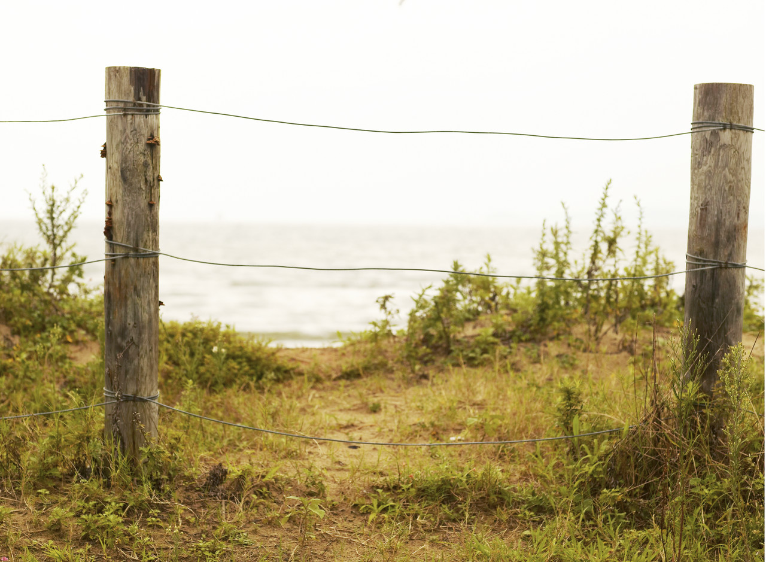
Set Some Posts and Signs!

Slide 67
Not a ‘LITTLE’ Fox
Get rid of that stubbornness.
Little foxes nibble at the vine, but the big foxes breed.

Slide 68
Little Foxes Spoil the Vine
When there is break the life flow is broken up.
Catch the foxes when they are little or they will spoil the vine when the tender grapes are just beginning to come.
Hang on to what you have got and drive some stakes down.
The foxes have tried it here.

Slide 69
Question 1:
How can you know if someone is a false prophet?
If you be led only by what you feel, you can still be led astray.
A false prophet is not known by feelings, but by what is taught.
You must know the truth.

Slide 70
Question 2:
What does a vine dresser do?
Take care of the area where the problem is. Care for the vineyard, bandage, prop, cut off…
As the vine heals fruit will begin to grow again.

Slide 71
CONCLUSION
Don’t let foxes spoil your vine.
Be the best at you are called to do.
Mark 16:15– And he said unto them, Go ye into all the world, and preach the gospel to every creature.

Slide 72
Keeping the Vineyard
Text: Song of Solomon 2:15
I. Subtlety of Her Enemy
II. Damage by Her Enemy
III. Most Critical Time

